Slide 1
Information System
ITEC-522
First Semester Third Year
Information Technology
Dr. Khalil-ur-Rahmen Khoumbati
Professor
Department of Information Technology
Faculty of Engineering and Technology
University of Sindh, Jamshoro
Khalil.khoumbati@gmail.com
Week #9

Slide 2
Information Systems Integration
The need for integration is not new but, it existed since applications moved from central processors to distributed systems and networks.
This need has emerged as disparate Information Systems (IS) that automate business processes have run on different computer platforms and have been based on a diversity of standards, operating systems and computer languages.

Slide 3
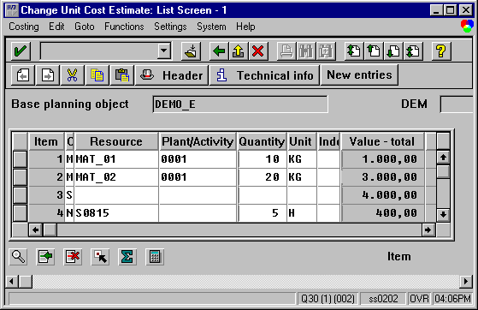
The Integration Problem
Sold to party: C100
10 6301 10
20 6412 10
30 1507 25
Database
Sales
Research and Development
Financials
Marketing
Production and Manufacturing
Sold to party: C100
10 6301 10
20 6412 10
30 1507 25
Database
Human Resource
Operations and Logistics

Slide 4
Problems
Integration is a serious problem
Each application has its own meaning of enterprise objects
Redundancy of data
High operational costs
Functional problems

Slide 5
Cont:
Initially, enterprises attempted to address integration by interconnecting their disparate applications but the number of interconnections required increased rapidly, as in many cases
each application had to be interconnected with all the others.
Themistocleous et al.(2001)estimate that for x applications a total of:
x*(x-1)/2

Slide 6
Cont:
To achieve interconnectivity among systems, programmers map data from source’s application format to target’s since applications require compatible data to store and manipulate them.
In support of this, programmers invade and alter the code of systems in order to map data and automate these interconnections.

Slide 7
Cont:
Therefore, the maintenance of these interconnected IT solutions becomes a serious issue for concern, as changes in one system often required the altering of all interconnected applications.
As a result, interconnection has proved a complex, cost consuming, non-flexible and non-manageable solution.

Slide 8
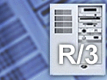
The Integration Problem
Enterprise Resource Planning Systems
Sold to party: C100
10 6301 10
20 6412 10
30 1507 25
Database
Sales
Research and Development
Financials
Marketing
Production and Manufacturing
Sold to party: C100
10 6301 10
20 6412 10
30 1507 25
Database
Human Resource
Operations and Logistics

Slide 9
ERP Systems
During the 1990s, Enterprise Resource Planning (ERP) technology emerged as an approach to integration problem.
ERP systems do not integrate disparate applications but, replace the need to integrate.
ERP systems are integrated software packages that automate core corporate activities such as finance, human resources, manufacturing and supply and distribution.

Slide 10
ERP Problems
Implementation is time consuming
Cost consuming , Not flexible
Problems with existing applications
Integration can not be achieved even if a company buys all its software from one ERP vendor.
ERP packages can not automate more than 30% of company’s applications. (Seeley, 1999).
ERP systems amplify the need for integration

Slide 11
ERP systems as monolithic solutions that are not designed to co-operate with other applications. As a result, enterprise integration can be achieved when organisations abandon existing applications and develop a complete ERP solution.

Slide 12
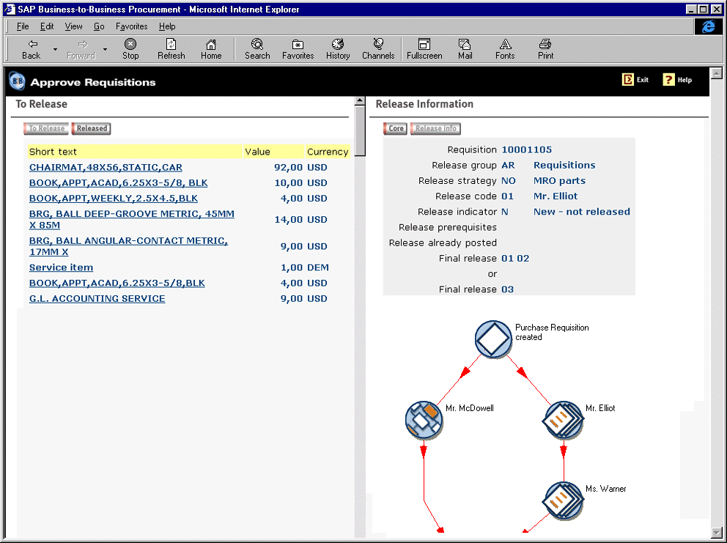
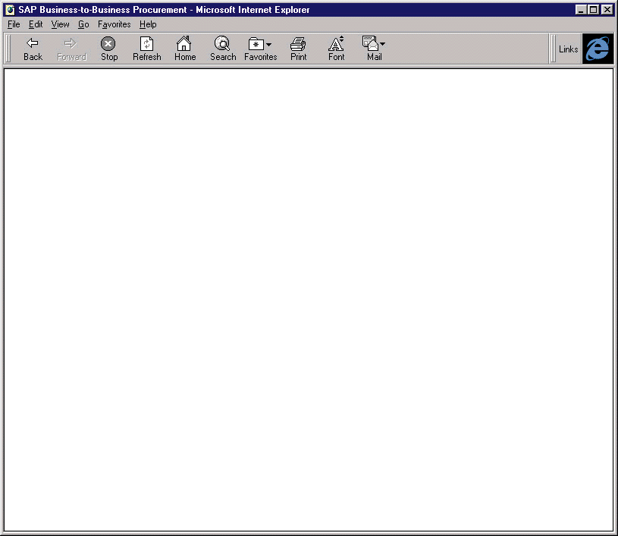
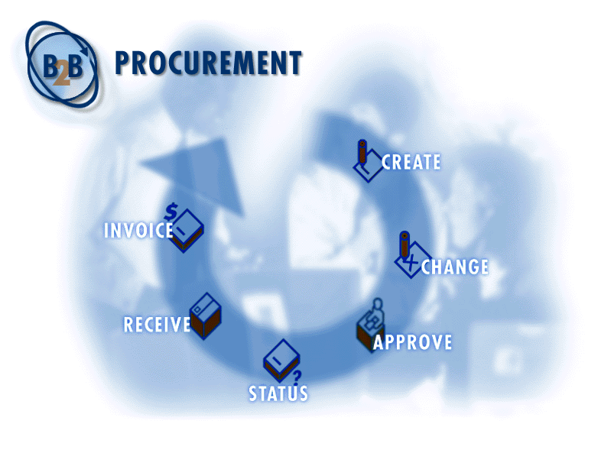
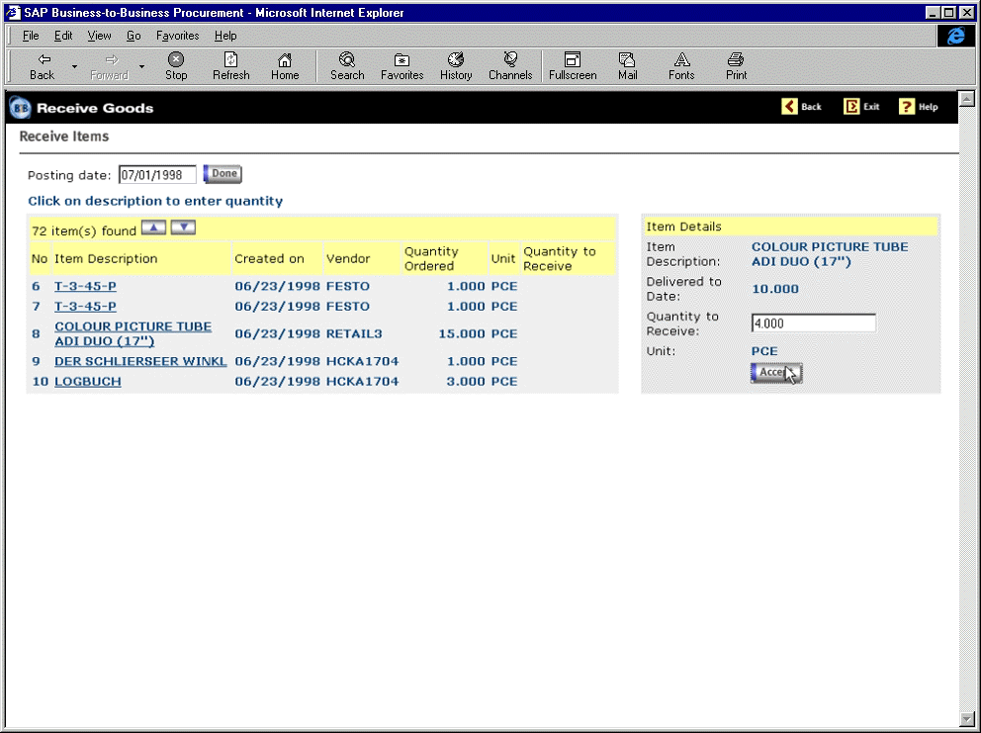
The Integration Problem
Sold to party: C100
10 6301 10
20 6412 10
30 1507 25
ERP
Legacy System
Custom Application
eSCM
eProcurement
eCRM
Sold to party: C100
10 6301 10
20 6412 10
30 1507 25
ERP
Legacy System
eStore

Slide 13
ERP systems as monolithic solutions that are not designed to co-operate with other applications. As a result, enterprise integration can be achieved when organisations abandon existing applications and develop a complete ERP solution.

Slide 14
Themistocleous et al. (2001) indicate that companies often do not adopt all ERP modules but a subset of them.
The reasons are many including: (a) enterprises use existing systems alongside ERPs; (b) ERP modules cost considerable amounts of money and, (c) there is a lack of time or justification to replace existing systems with new ERP modules

Slide 15
Classifications of System Types that are Integrated
Classifications of System Types
Description
Custom to Custom Integration
Custom applications like legacy applications and data warehouses are frequently integrated in a common infrastructure, to fully automate business processes. A typical scenario of this classification could be the incorporation of legacy systems that deal with promotions management (e.g. stocks, suppliers accounts).
Custom to Packaged Integration
This is a common approach when organisations adopt EAI since packaged applications like Enterprise Resource Planning (ERP) systems have in many cases failed to achieve integration and co-exist alongside custom applications. A typical scenario of this type could be the integration of a legacy system that deals with production and an ERP module that handles customer orders or suppliers’ details/accounts.
Custom to ebusiness
Integration
Many ebusiness solutions require a close collaboration with legacy applications to support ebusiness enabled processes and tasks. As a result, custom applications (e.g. stocks) are incorporated with ebusiness systems to integrate and automate inter-organisational business processes. In many cases the functionality of an ebusiness solution is used to support custom systems. For instance, an e-store updates a custom system that deals with stock availability. The information provided by the ebusiness solution is critical not only for the functionality of stock application but, also for the whole supply chain as it supports the automation and integration of specific business processes.
Packaged to Packaged
Integration
In this case, disparate packaged systems such as different versions of an ERP system or many ERP modules that exist in one organisation are unified into a common integrated infrastructure. For instance, after a merger or acquisition there is a need to integrate the various ERP systems that exist both in mother company and its subsidiaries.
Packaged to ebusiness
Integration
Organisations take advantage of EAI and Electronic Commerce technology when they integrate their ebusiness solutions with packaged applications as ERP systems can be used as back-office system to support the ebusiness functionality (front end application). In this case, processes that usually deal with e-sales, e-procurement and e-supply chain management can be integrated with packaged systems.
Ebusiness to ebusiness
Integration
In this approach, an ebusiness application is integrated and supports the functionality of another ebusiness solution. For example an electronic point of sales is incorporated with e-supply chain management to share data that are important for the latter application (e.g. customer orders, customer details etc).
Custom to Packaged to ebusiness Integration
Such approaches focuses on the development of an integrated infrastructure that integrates processes and applications on departmental, enterprise or cross-enterprise level. For instance, an estore is integrated with the financial module of an ERP system and a legacy system that deals with stocks availability.

Slide 16
Application Spaghetti Vs
Enterprise Application Integration
Traditional Integration Approaches - Application Spaghetti
Application 1
Application 2
Application 3
Application 4
Application 5
Application 6
Enterprise Application Integration
Application 1
Application 2
Application 3
Application Integration
Application 4
Application 5
Application 6

Slide 17
ERP System
Internal Applications
(Java,C,C++)
CRM System
EAI
Enterprise Portal
Application
Databases
Financial System
Legacy System
SCM System

Slide 18
Supply Chain Management (SCM) needs to be integrated with intra and inter-organisational systems, as it shares critical information between the partners of a supply chain (e.g. suppliers, distributors, retailers etc.).

Slide 19
According to Morgenthal and La Forge e-commerce applications have to be incorporated with back-office systems to automate and integrate
business processes and support real-time transactions.

Slide 20
The reason for this is that e-commerce applications are not integrated solutions. As a result, there is a need to piece together ecommerce solutions with existing IT infrastructures to allow them to function in an integrated way thus, allowing enterprises gain e-commerce advantages.

Slide 21
Enterprise Application Integration (EAI)
EAI is a new generation of integration software that incorporates functionality from disparate systems and leads to flexible and maintainable solutions.
It addresses more effectively the need to integrate both intra and inter-organisational systems by incorporating functionality from disparate applications and thus, maximise their benefits from the use of e-commerce and e-business applications.

Slide 22
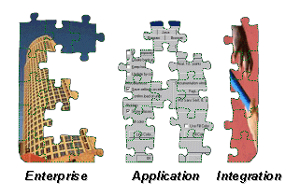
A Promising Solution
Inter-connectivity
ERP
Legacy System
Custom Application
Sold to party: C100
10 6301 10
20 6412 10
30 1507 25
SCM
eProcurement
CRM

Slide 23
Enterprise Application Integration (EAI)
ERP
Custom Application
eSCM
eCRM
Sold to party: C100
10 6301 10
20 6412 10
30 1507 25
eStore
Legacy System

Slide 24
Integration Technologies
Database Oriented Middleware
Message Based Technologies
Transaction Based Technologies
Distributed Object Technologies
Interface Based Technologies
Table 3.2: Integration Requirements based on Characteristics of EAI Technologies

Slide 25
Cont:
EAI results in supporting data, objects and processes incorporation as well as custom applications, packaged systems and e-business solutions integration.

Slide 26
A Novel Taxonomy for Classifying Types of EAI
SI Markus (2000)
AI Sprott
EAI Zahavi (1999)
EAI Brown (2000)
Enterprise Application Integration
EBI Markus (2000)
Category 1
Category 3
Category 2
Intra-organisational
Application Integration
Hybrid Application Integration
Inter-organisational
Application Integration
Packaged Systems
Custom Applications
Business to Consumer
Extended Enterprises
Virtual Enterprises
ERP systems
Legacy systems
e-services
e-stores
Supply Chain
e-procurement
SCI Linthicum (1999a)
VCI Yang and Papazoglou (2000)
EAI Duke et al. (1999)
e-business I Linthicum (2000)

Slide 27
Application Elements
Integration Layers
  Data
  Objects
  Processes
  Transportation Layer
  Transformation Layer
  Process Automation Layer
Classification of System Types
Integration Requirements
  Custom-to-Custom
  Custom-to-Packaged
  Custom-to-ebusiness
  Packaged-to-packaged
  Packaged-to-ebusiness
  Custom-to-Packaged-ebusiness
  Maintainability
  Flexibility
  Scalability
  Portability
  Reusability
  Maturity
  Complexity
  Non-invasive
  Performance
  Real-Time
  Mainframe compatible
  Non-Mainframe compatible

Slide 28
Discussion
Questions?

